Slide 1

MTECH AAI COHORT-1 Dissertation Project – Phase II
Evaluation-I
Presented by: Sanjeev Kumar Pandey
Enrolment No: MT23AAI001
Project Guide: Dr. Amit Agrawal

Slide 2
Human ID & Activity Prediction using Wi-Fi Signals
Leveraging Wi-Fi Channel State Information (CSI) and RSSI
Sanjeev Kumar Pandey | 10-Sep-2025

Slide 3
Project Objectives
Dataset Aim: Wi-Fi-based Human Activity Recognition (HAR) in indoor environments (LOS & NLOS).
Objective 1: Detect the activity action type from Wi-Fi signals.
Objective 2: Detect the ID of the person performing the activity.

Slide 4
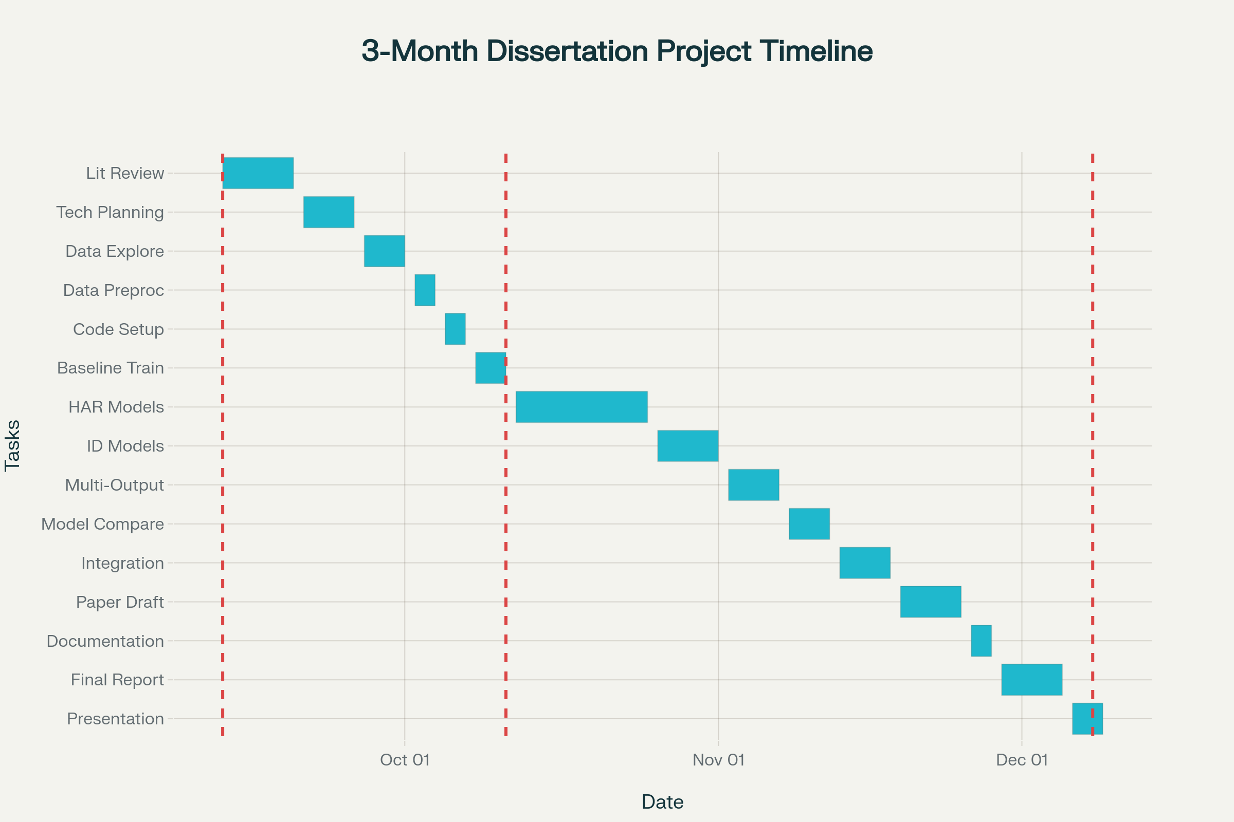

Slide 5
Planning overview
Literature Review & Planning: Start with reading key papers, setting objectives, and technical planning.
Data Understanding & Preprocessing: Explore dataset, feature extraction, and handle CSI/RSSI preprocessing.
Initial Coding & Baseline Model (Eval 1): Set up coding, implement baseline models, run initial training and evaluation.
Advanced Model Training & Experimentation (Eval 2): Design and train advanced models (HAR, Human ID, multi-output), experiment, and tune.
Analysis & Integration: Compare results, integrate best-performing models, and conduct error analysis.
Research Paper Drafting & Documentation: Start documentation and research paper draft, plus slides for presentation.
Final Report & Presentation (Eval 3): Polish final report, prepare for oral defense, and respond to committee feedback.

Slide 6
Dataset Overview
Source Paper: 'A dataset for Wi-Fi-based human activity recognition in LOS and NLOS indoor environments'. https://pmc.ncbi.nlm.nih.gov/articles/PMC7704290/pdf/main.pdf
Authors: Baha’ A Alsaify et al., Jordan University of Science and Technology, German Jordanian University.
Publication Date: November 18, 2020.
Purpose: Benchmark dataset for HAR research across LOS & NLOS settings.

Slide 7
Key Features of Dataset
Participants: 30 subjects (28 male, 2 female), age ~22.7 ± 2.95 years.
Activities: 12 unique actions across 5 experiment classes.
Environments: 2 LOS (lab, hallway) + 1 NLOS (wooden wall barrier).
Data Types: Channel State Information (CSI) and RSSI values.
File Naming: Ex_Sy_Cz_Ai_Tk.csv (e.g., E1_S04_C3_A7_T17.csv).

Slide 8
Feasibility of Human ID Prediction
Subject ID explicitly labeled in filenames (S1–S30).
Biometric info (age, weight, height) subtly affects signals.
CSI & RSSI are sensitive to individual movement signatures.
Rich dataset (3000 trials) suitable for Human ID modeling.

Slide 9
Use Case: Security & Monitoring
Traditional biometrics (faces, fingerprints) can be spoofed & require active participation.
Wi-Fi-based ID is passive, non-intrusive, and works in NLOS environments.
Applications: High-security zones (ISRO, NASA, Parliament House), covert surveillance, medical alerts.

Slide 10
Target Variables
HAR Activity Recognition: Classify 12 unique activities (A1–A12).
Human ID: Identify 1 of 30 subjects (S1–S30).
Input Data: CSI & RSSI values sensitive to presence & movement.

Slide 11
Model Development Approaches
Approach 1: Two Separate Models
HAR Activity Classifier (12 classes).
Human ID Classifier (30 subjects).
Approach 2: One Multi-Output Model
Single model with shared features.
Two output heads: Activity & ID.

Slide 12
Conclusion & Next Steps
Dataset provides rich labeled Wi-Fi signal data (CSI, RSSI).
Suitable for both HAR and Human ID tasks.
Choice: Separate models (simplicity) vs. Multi-output model (efficiency).
Next Step: Implement and evaluate both approaches.

Slide 13
MTECH AAI COHORT-1 Dissertation Project – Phase II
Evaluation-II
Presented by: Sanjeev Kumar Pandey
Enrolment No: MT23AAI001
Project Guide: Dr. Amit Agrawal
Date: 11-Oct-2025

Slide 14
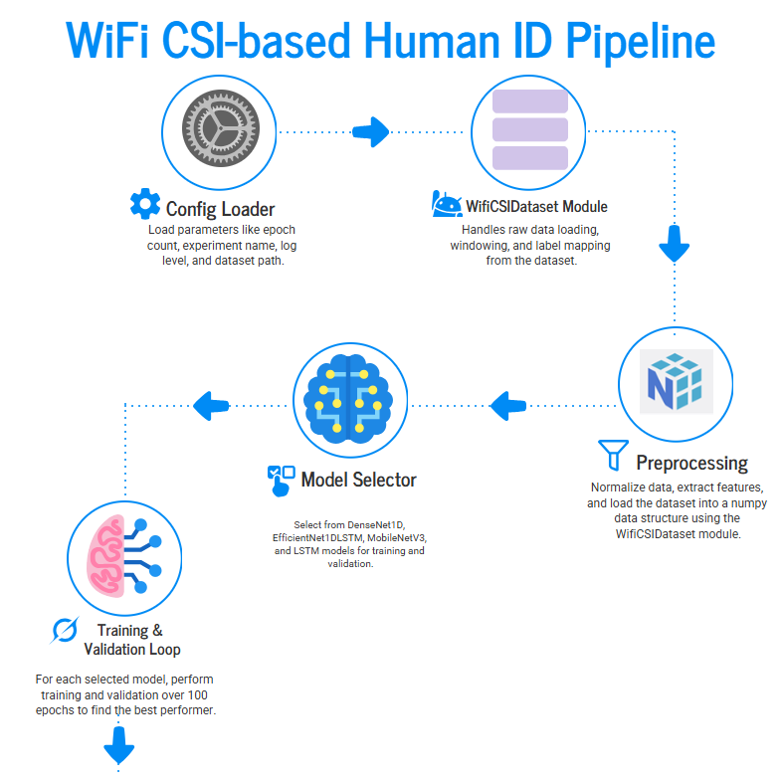

Slide 15
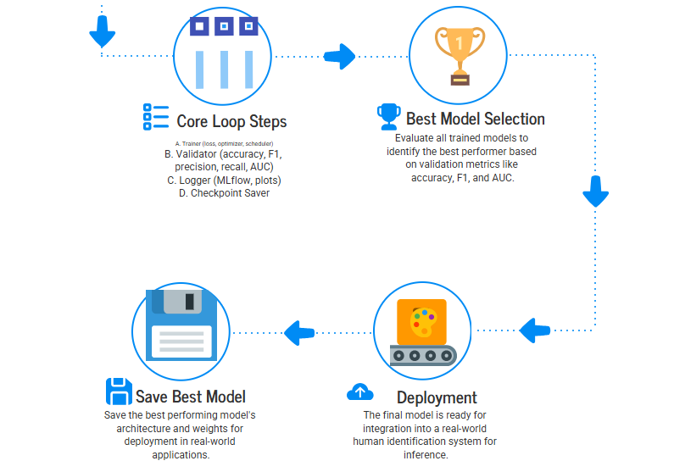

Slide 16
Project Objective
The project performs a comparative study across four distinct DL architectures, all designed to process both the time-series CSI sequence and the auxiliary metadata sequence simultaneously.
Model Name | CSI Processing Core | Metadata Processing Core | Key Features
CSILSTMNet | Standard LSTM | Standard LSTM | Uses the last hidden state from two parallel LSTMs (one for CSI, one for Meta).
DenseNet1D | Dense Block 1D CNN | Bidirectional LSTM | Uses 1D CNN blocks (DenseBlock1D) followed by global pooling for CSI, combined with a Bi-LSTM for metadata.
EfficientNet1DLSTM | MBConv1D Blocks | Bidirectional LSTM | Leverages Mobile Inverted Bottleneck (MBConv) blocks (stem, mbconv1-3) designed for efficiency, combined with a Bi-LSTM.
MobileNetV3_1D_LSTM | MobileNetV3 Block 1D | Bidirectional LSTM | Incorporates specialized blocks (including depthwise separable convolutions and Squeeze-and-Excitation (SE) layers) optimized for mobile/efficient computing, combined with a Bi-LSTM.

Slide 17
MLflow Integration
Feature Focus: Seamless integration with MLflow for experiment tracking and performance comparison.
What It Does:
Automatically logs training runs for all four models — DenseNet1D, EfficientNet1DLSTM, MobileNetV3_1D_LSTM, and LSTM.
Captures hyperparameters, metrics (Accuracy, F1, Precision, Recall, AUC), and loss curves per epoch.
Why It Matters:
Enables side-by-side model comparison through MLflow dashboards and visual graphs.
Ensures reproducibility and transparency of experiments.
Simplifies identification of the best-performing model over 100 epochs.
Outcome: Data-driven insights for model selection and performance optimization.

Slide 18

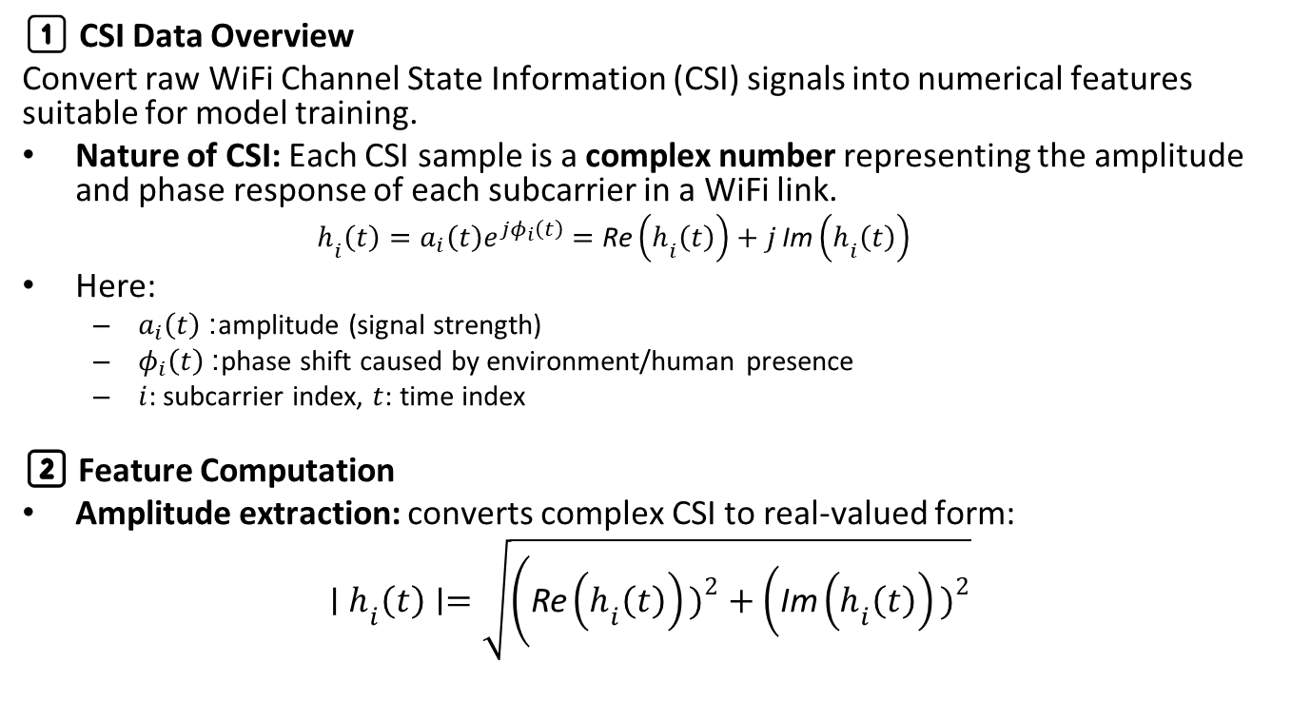
CSI Data
1️⃣ CSI Data Overview
Convert raw WiFi Channel State Information (CSI) signals into numerical features suitable for model training.
Nature of CSI: Each CSI sample is a complex number representing the amplitude and phase response of each subcarrier in a WiFi link.
$$h_{i}\left(t\right)=a_{i}\left(t\right)e^{jφ_{i}\left(t\right)}=\text{Re}\left(h_{i}\left(t\right)\right)+j \text{Im}\left(h_{i}\left(t\right)\right)$$
Here:
$a_{i}\left(t\right)$: amplitude (signal strength)
$φ_{i}\left(t\right)$: phase shift caused by environment/human presence
$i$: subcarrier index, $t$: time index
2️⃣ Feature Computation
Amplitude extraction: converts complex CSI to real-valued form:
$$∣h_{i}\left(t\right)∣=\sqrt{\left(\text{Re}\left(h_{i}\left(t\right)\right){\left.)\right.}^{2}+\left(\text{Im}\left(h_{i}\left(t\right)\right){\left.)\right.}^{2}\right.\right.}$$

Slide 19
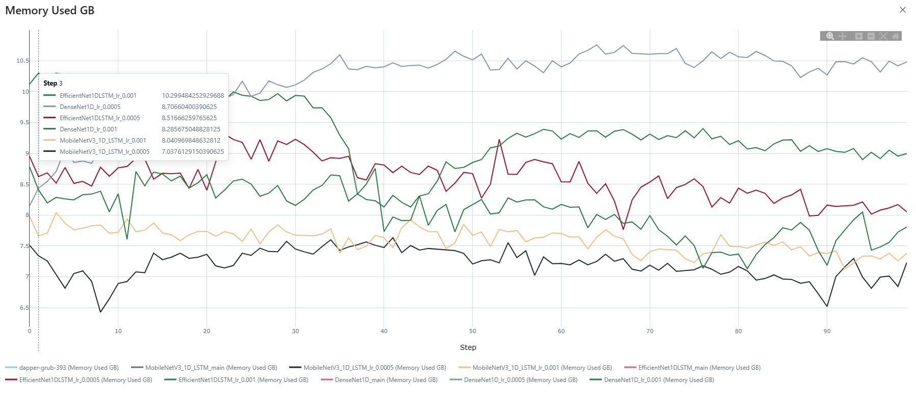

Slide 20
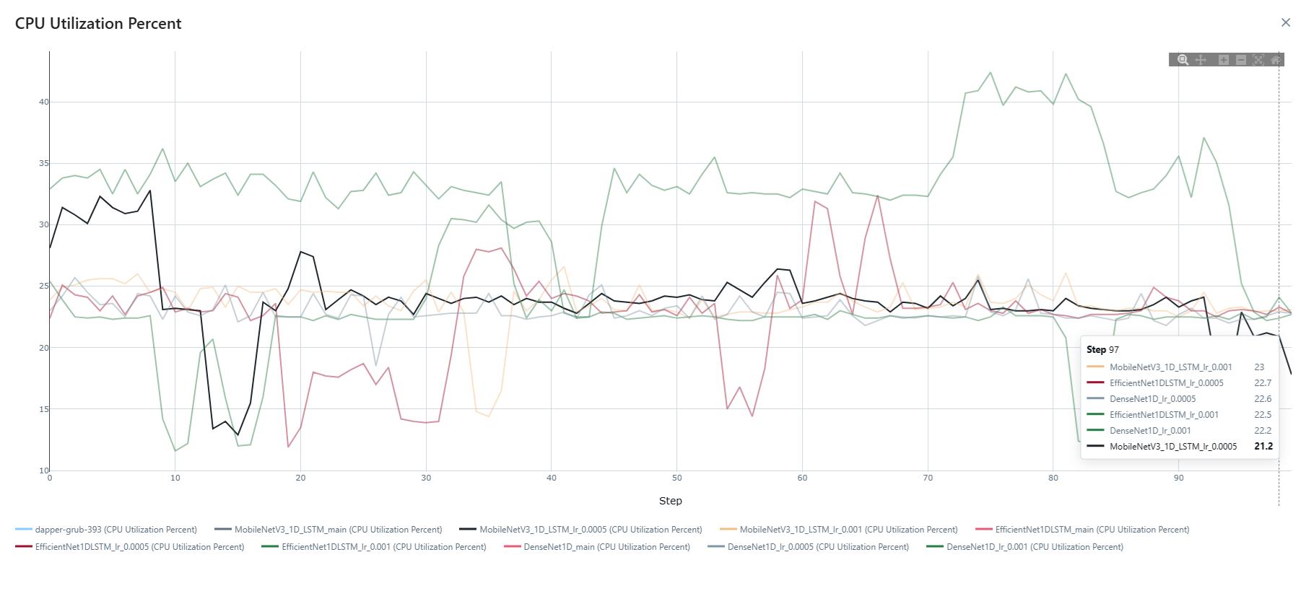

Slide 21
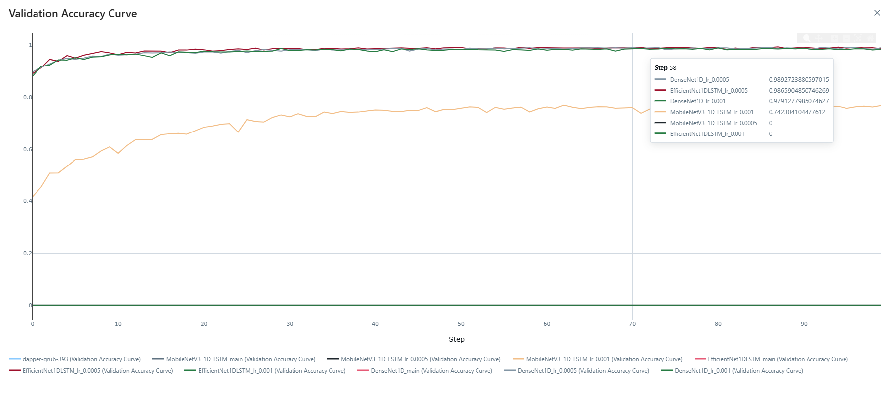

Slide 22
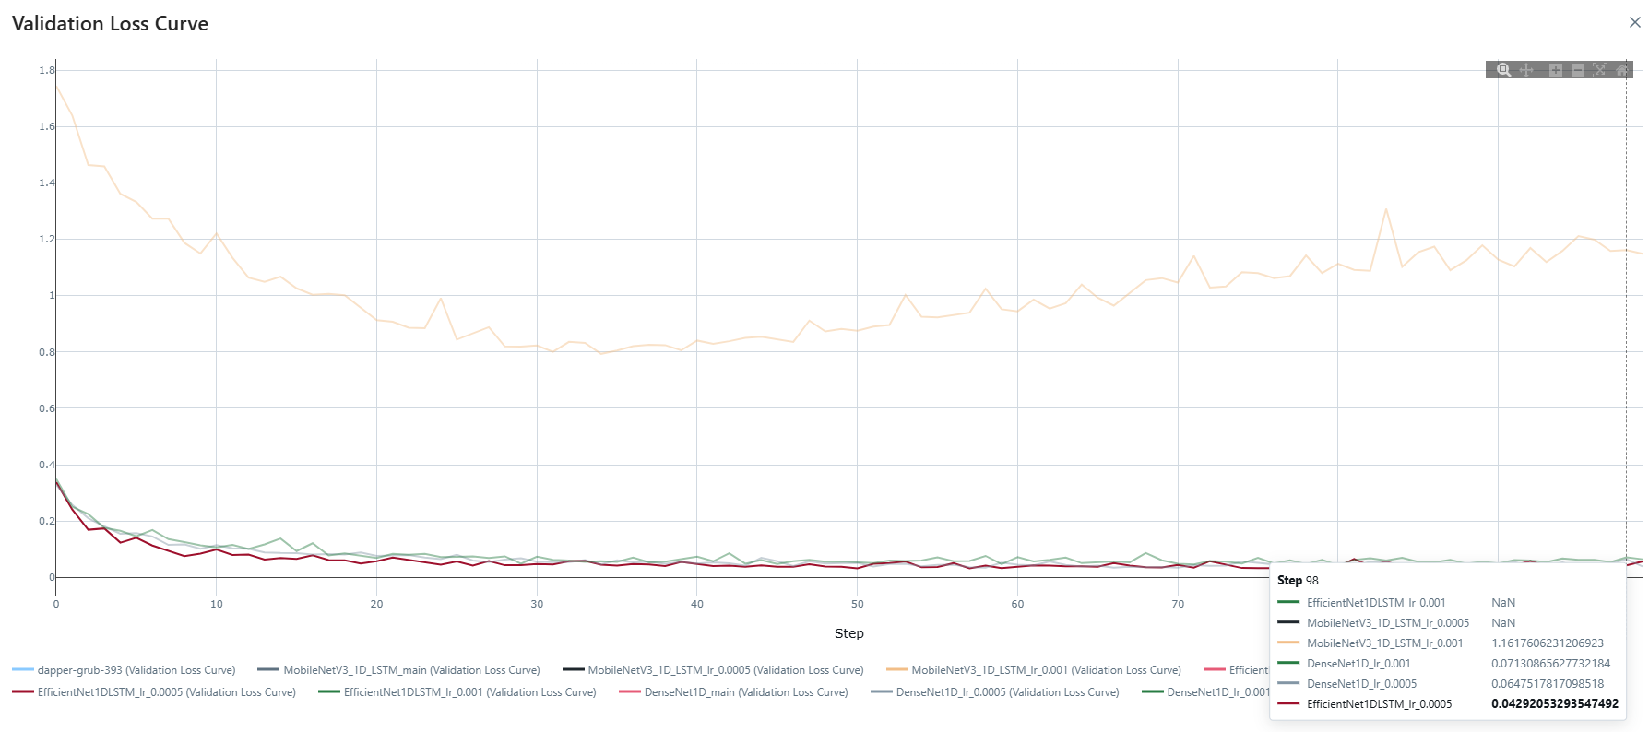

Slide 23
Best Model
Model Performance Comparison
Objective: Evaluate four DL models on experiment data using two learning rates (0.001, 0.0005)
Top Performing Models:
DenseNet1D (lr=0.0005): Best overall metrics
EfficientNet1DLSTM (lr=0.0005): High, consistent metrics
CSILSTMNet (lr=0.0005, 0.001): Slightly below leaders
MobileNetV3_1D_LSTM (lr=0.001): Lower but strong metrics
Model | Learning Rate | Best Validation Accuracy | Best Validation Precision | Best Validation Recall | Best Validation F1 Score
DenseNet1D | 0.0005 | 0.999938 | 0.999938 | 0.999938 | 0.999938
EfficientNet1DLSTM | 0.0005 | 0.99993 | 0.99993 | 0.99993 | 0.99993
DenseNet1D | 0.001 | 0.999904 | 0.999904 | 0.999904 | 0.999904
CSILSTMNet | 0.0005 | 0.999826 | 0.999826 | 0.999826 | 0.999826
CSILSTMNet | 0.001 | 0.999814 | 0.999814 | 0.999814 | 0.999814
MobileNetV3_1D_LSTM | 0.001 | 0.988529 | 0.988529 | 0.988529 | 0.988529

Slide 24
Insights & Conclusions
Learning Rate Tuning: Lower learning rate (0.0005) consistently outperforms 0.001 for all models
Metric Trends: Metrics (accuracy, precision, recall, F1) closely match for each model configuration, indicating balanced performance
Best Model: DenseNet1D with lr=0.0005 is the optimal choice for this experimental dataset
Generalization: High and consistent validation scores suggest good model generalization and minimal overfitting issues across the experiments​

Slide 25
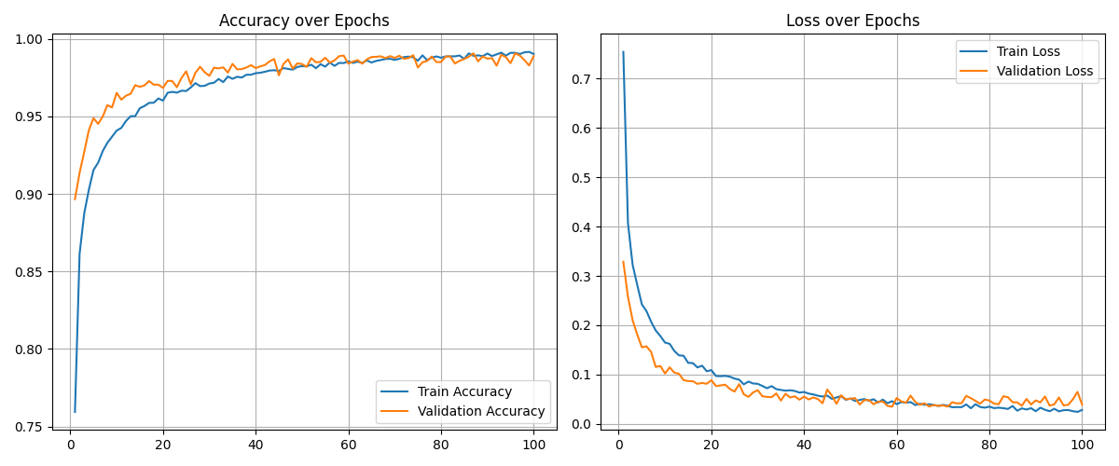
DenseNet1D with lr=0.0005 Plot

Slide 26
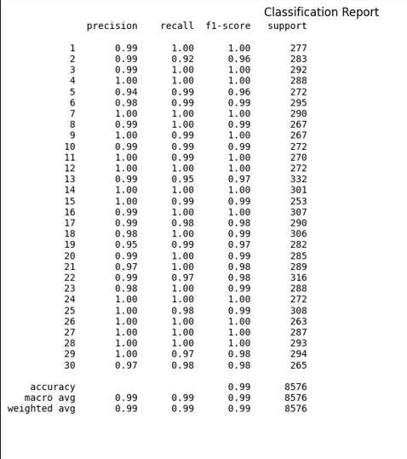
DenseNet1D with lr=0.0005 Plot

Slide 27
Thank you

